Slide 1

Lumberjack
Christine Chen
Notes:
(No Notes)

Slide 2
Christine

Slide 3

The team: Kobayashi
Notes:
The team is responsible for pulling data from a number of intuit products, standardizing this data, and moving it to the IAT (Intuit Analytics Cloud) for further analysis.

Slide 4

Additional Kobayashi Info
Notes:
Fun Facts:
Kobayashi pulls data from 90 data sources and over 3400 tables. 1.9 TB are ingested daily to IAC (Intuit Analytics Cloud). One of the biggest datasets, QBO Audit Info, pulls 30M rows per day.

Slide 5
Data Ingestion Process Overview (Part 1)
Ingest
Transform
Notes:
There are four primary stages within the data ingestion process
The ingestion stage queries the various kinds sources directly to fetch the desired data
The transform stage identifies sensitive financial or personal info and encrypts this data before proceeding

Slide 6
Data Ingestion Process Overview (Part 2)
Validate
Merge
Notes:
3. The validation stage verifies that sensitive data has been properly encrypted and has not been corrupted during the previous stages
4. The merge stage consolidates the new dataset into the Hadoop database for long-term storage and data analytics

Slide 7
Data Ingestion Challenges
RDBMS
sqoop
IAC
Vertica
Hive
sqoop
RDBMS
DB Change Events
In backlog
sqoop
Kobayashi
Flat File
dragline
Vertica
S3
Kobayashi Database
Intuit Metadata Tool
API Plugin
Notes:
This process is very complex because we are pulling from a number of different types of databases, handle very large datasets, encrypt/transfer financial data security and handle dirty data. These challenges make the process prone to errors

Slide 8
The Problem
Notes:
When transferring this amount of data from a number of different sources with changing conditions, things are likely to go wrong. Unfortunately, errors during data ingestion can cause permanent data loss or corruption which can cause serious problems

Slide 9

Notes:
Every night, there is a person on our team on call for the daily batch ingestion. If something goes wrong, they get woken up in the middle of the night and must figure out what caused the issue/failures to occur.

Slide 10
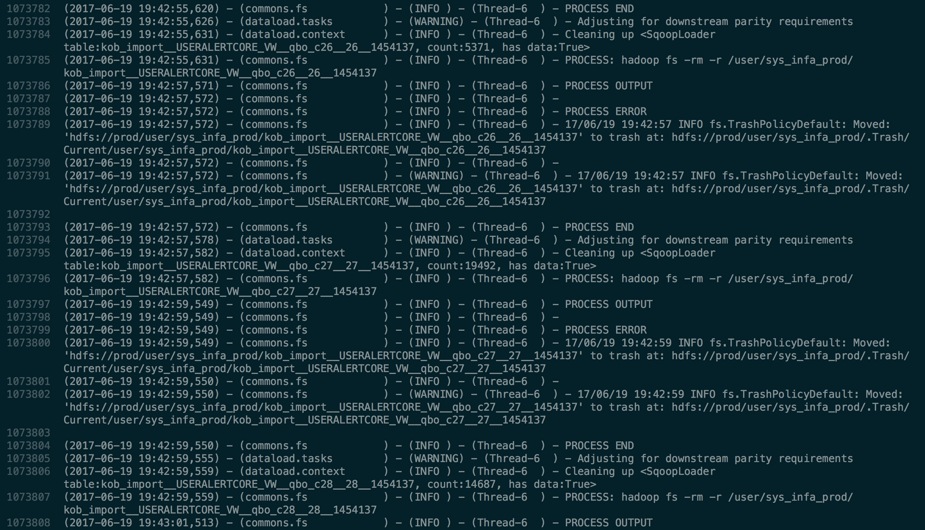
Notes:
The logs can help our teammates figure out what went wrong, but take a look. The ingestion of this application output more than 1 million lines. The logs are ugly and tedious to look at.
In addition, many of the applications that are ingested are multithreaded, so it is difficult to figure out some basic metrics such as how long it takes for a workflow to be processed.
(Condense or split)

Slide 11
The Solution: Lumberjack
Notes:
Our project helps simplify the debugging process and ideally reduce the amount of time required to diagnose and resolve errors during the ingestion process. Lumberjack parses raw log files to analyze and display the most important information as well as calculating historical statistics.

Slide 12

Algorithm
Notes:
Our parser first iterates through the log file line by line to filter out the unnecessary data and identify key events. The next stage of our algorithm iterates through these raw events to create Operation objects (which represent one of the four data ingestion stages).

Slide 13
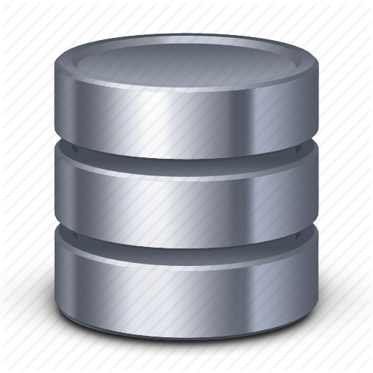
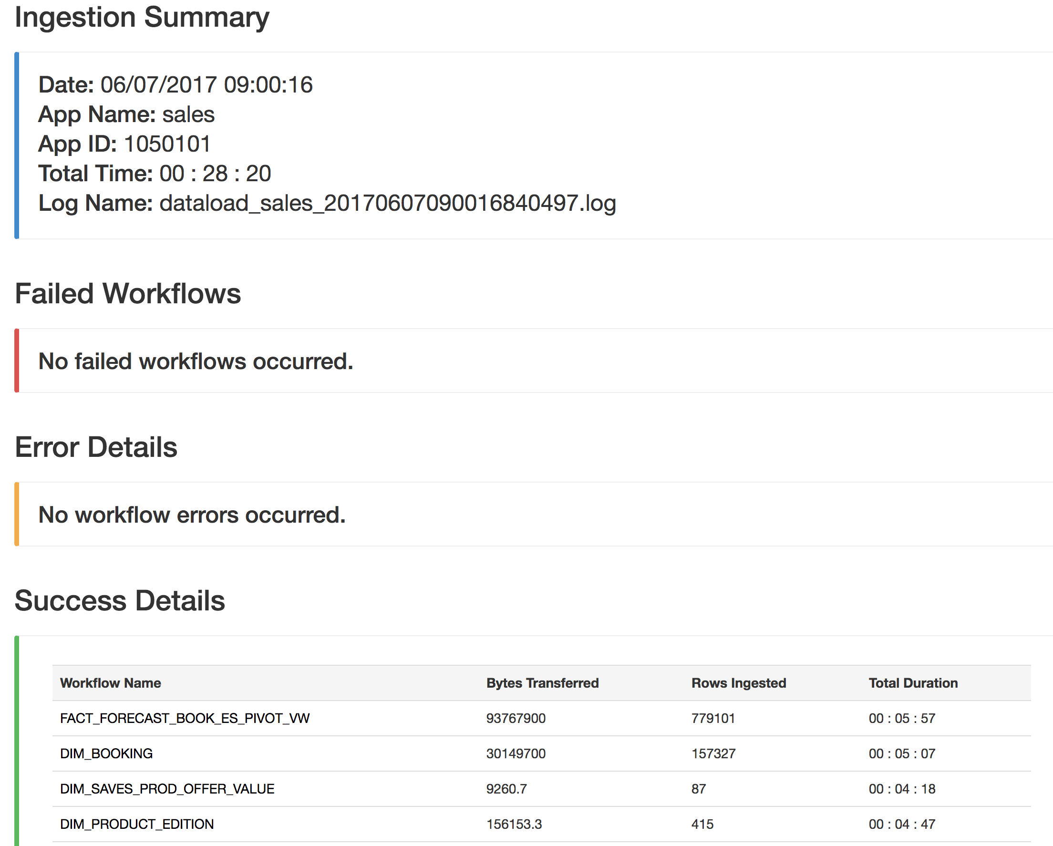
UI/Database
Notes:
The application page gives a high level summary of what occurred during the ingestion, showing basic statistics such as workflow errors, failures, and successes. Workflow pages give in depth details including metrics specific to the workflow and displays trends/history of past ingestions by pulling information from the database.
(5-10 seconds long)

Slide 14
Application Page

Slide 15
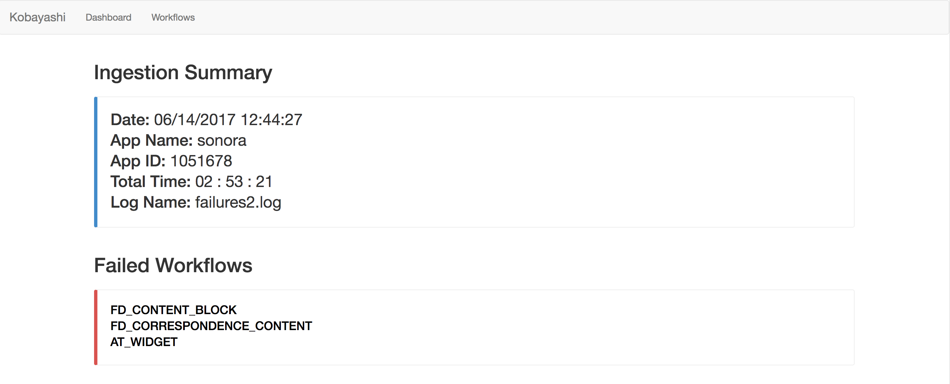
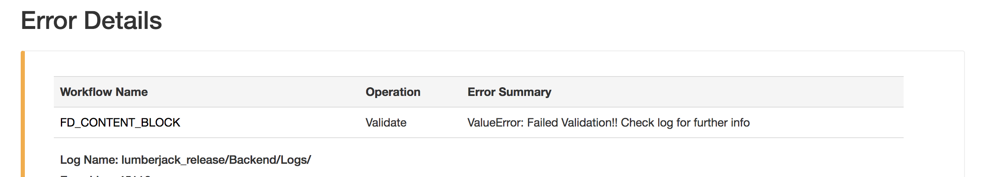

Slide 16
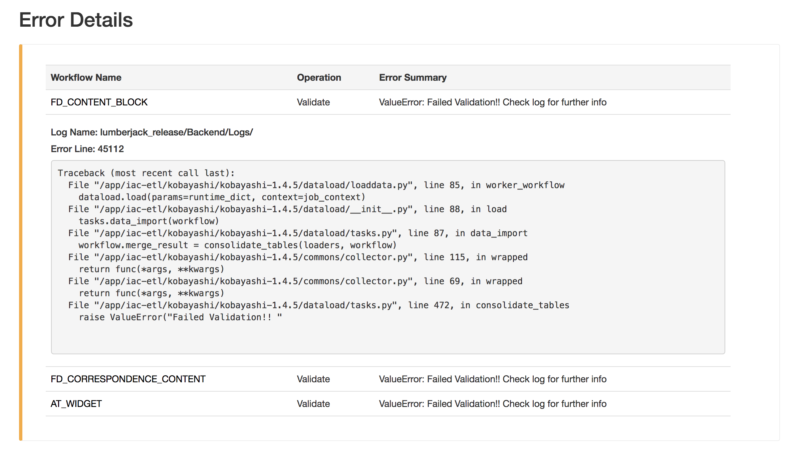

Slide 17
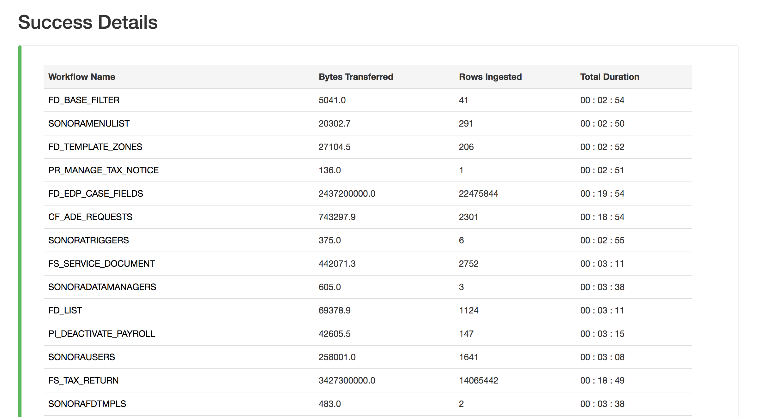

Slide 18
Workflow Page

Slide 19
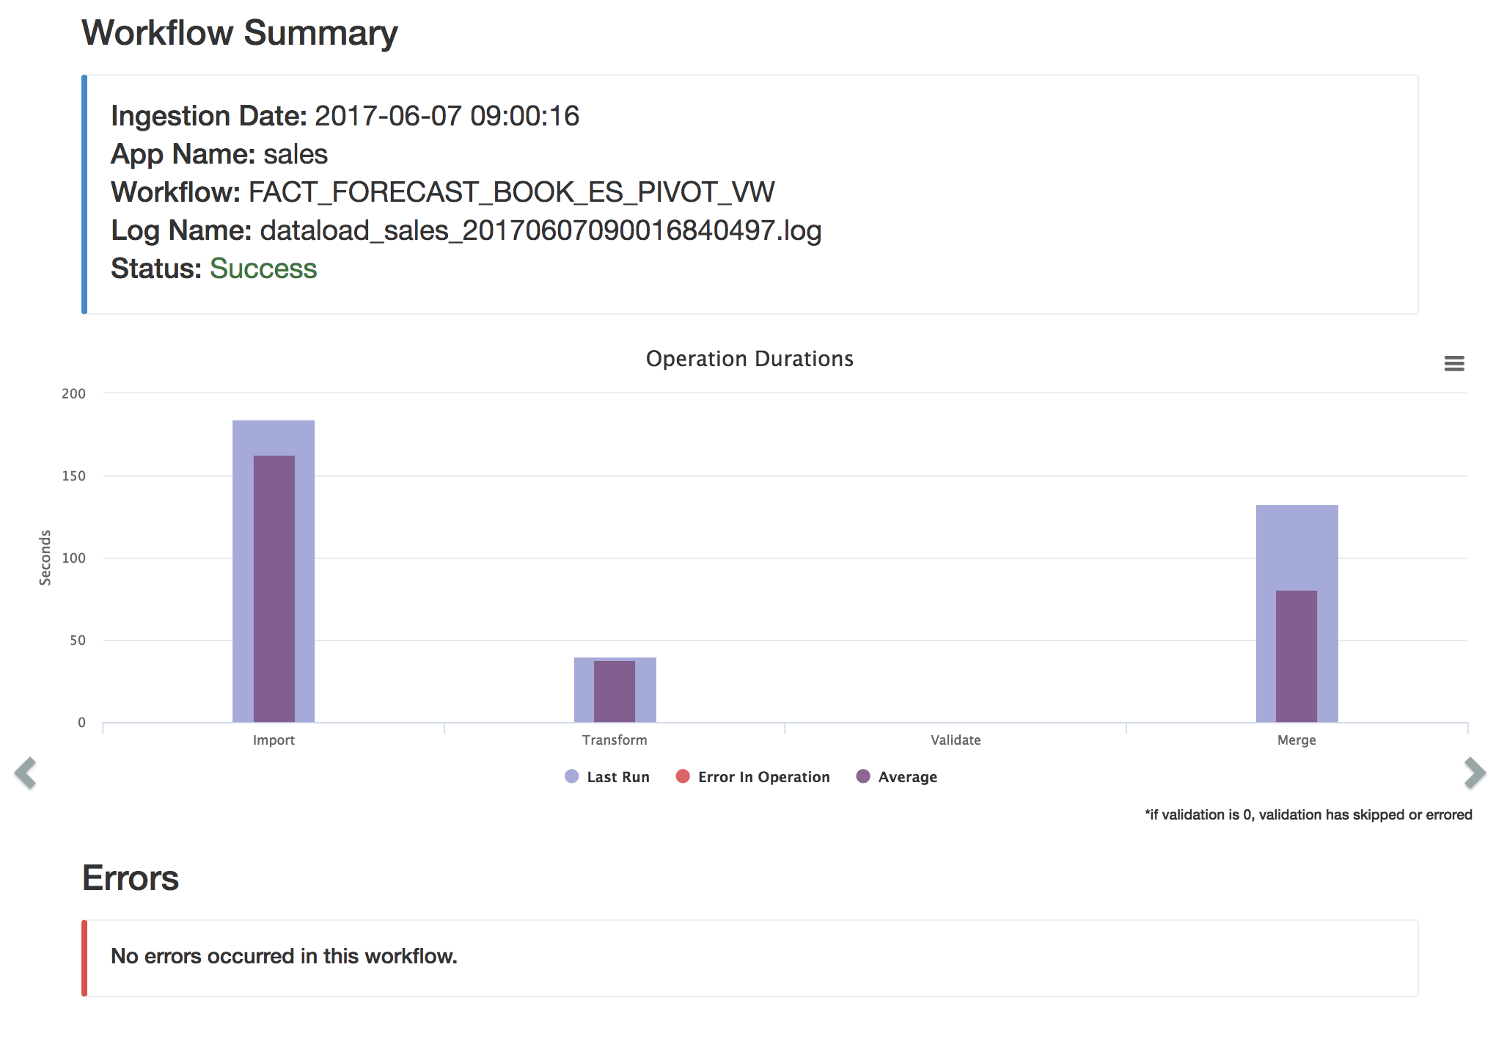

Slide 20
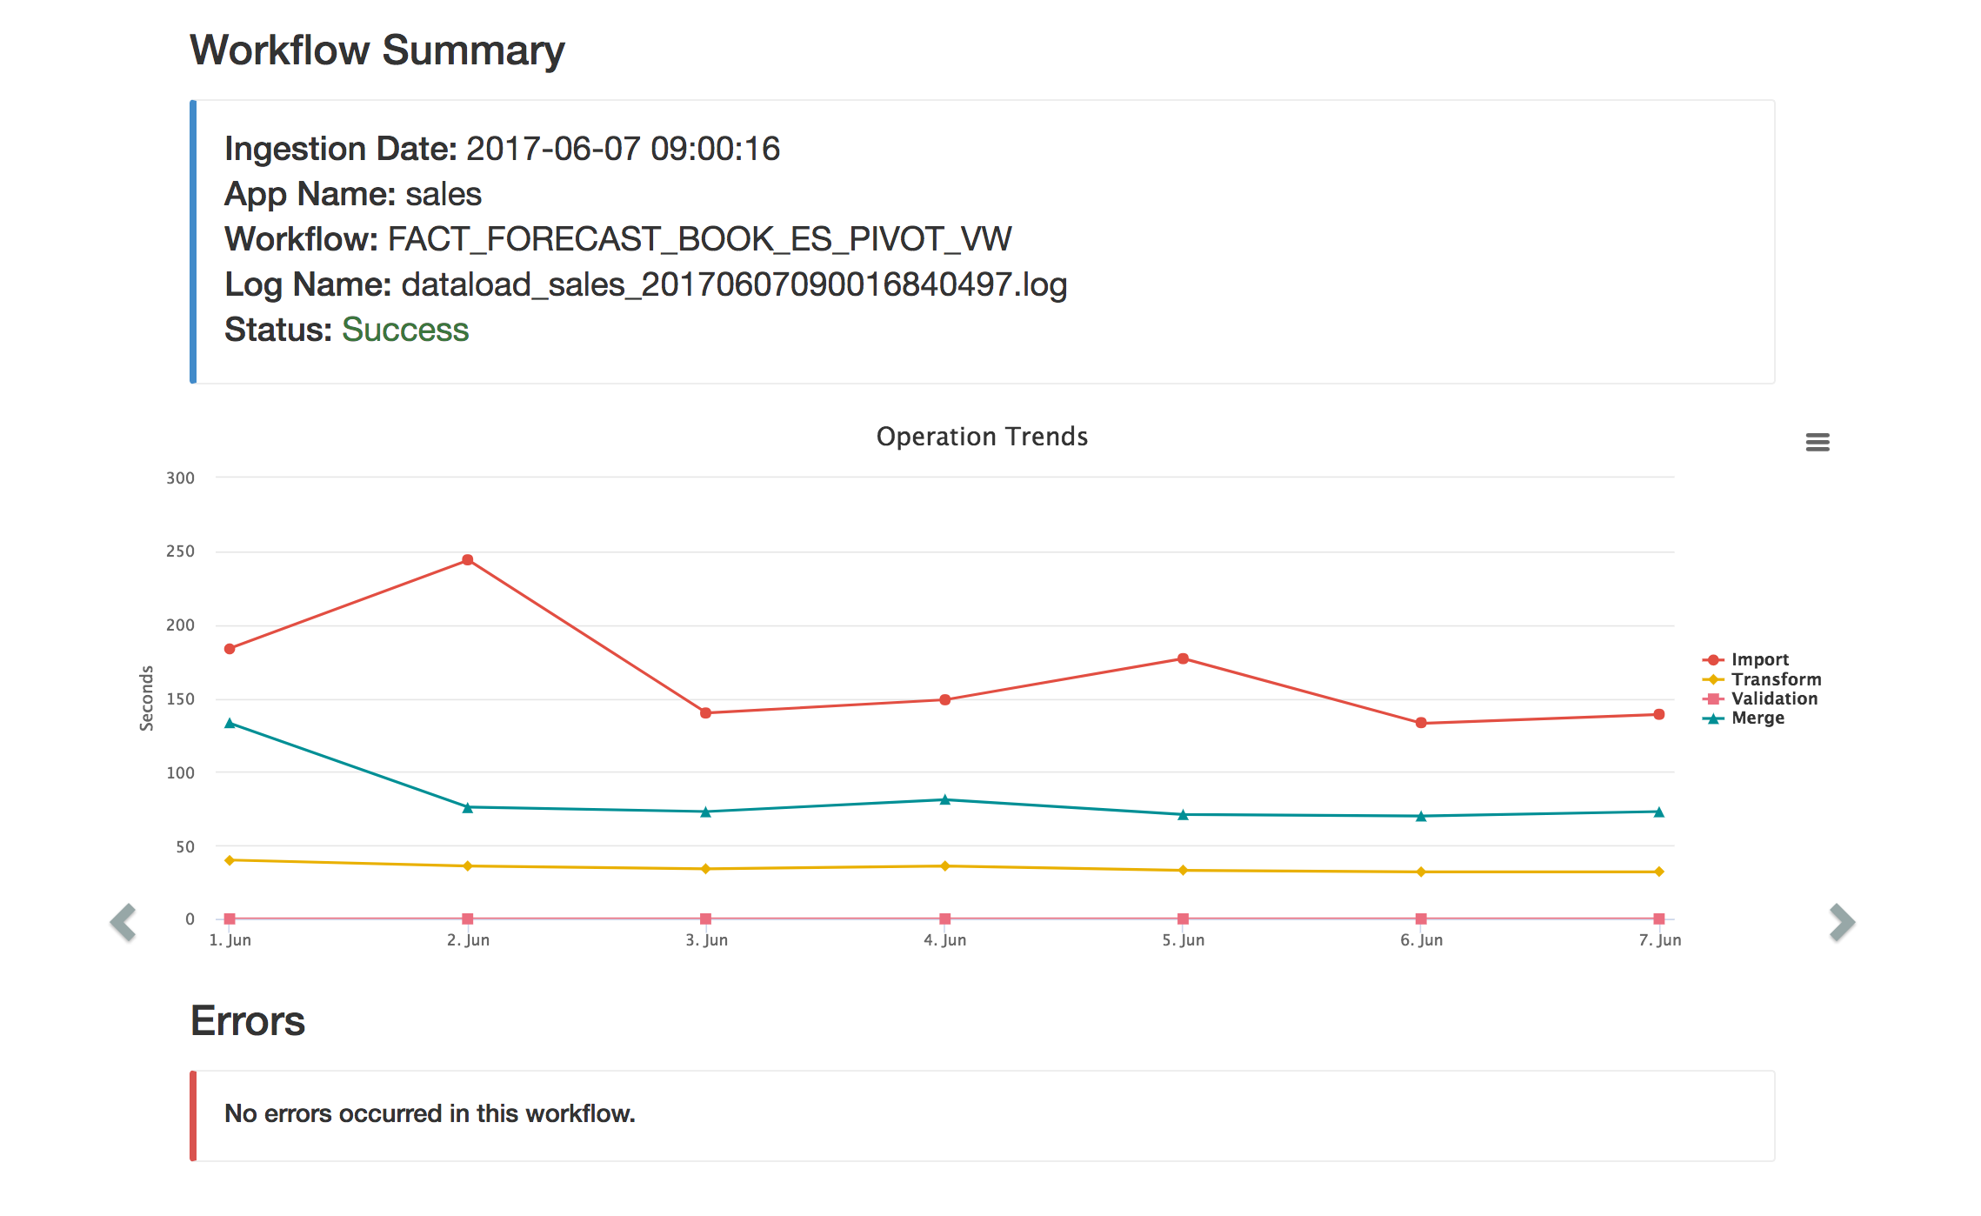

Slide 21
Conclusion
Notes:
Lumberjack will be used to parse important information about daily batch ingestions and help pager duty individuals troubleshoot failures that have occurred in the Kobayashi framework.

